Slide 1
Software Development Environment
Zynq
Vivado 2014.2 Version

Slide 2
Objectives
After completing this module, you will be able to:
Understand the basic concepts of the Eclipse IDE in SDK
List SDK features
Identify the GNU tools functionality
List steps in creating a software application
State when address management is needed
Describe the object file sections
Describe what a linker script does

Slide 3
Outline
Introduction
SDK Development Environment
SDK Project Creation
GNU Development Tools: GCC, AS, LD, Binutils
Software Settings
Software Platform Settings
Compiler Settings
Address Management
Object File Sections
Linker Script
Summary

Slide 4
Desktop versus Embedded
Desktop development: written, debugged, and run on the same machine
OS loads the program into the memory when the program has been requested to run
Address resolution takes place at the time of loading by a program called the loader
The loader is included in the OS
The programmer glues into one executable file called ELF
Boot code, application code, RTOS, and ISRs
Address resolution takes place during the gluing stage
The executable file is downloaded into the target system through different methods
Ethernet, serial, JTAG, BDM, ROM programmer

Slide 5
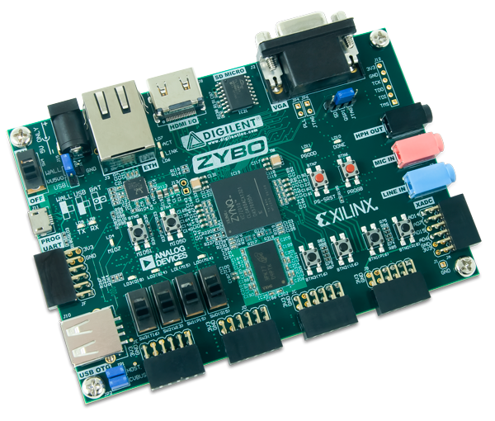
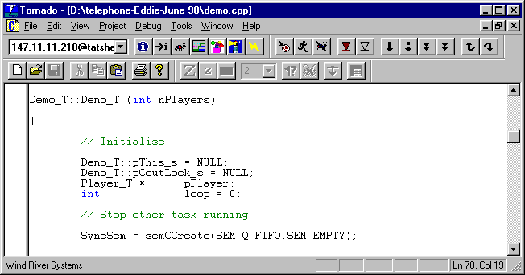
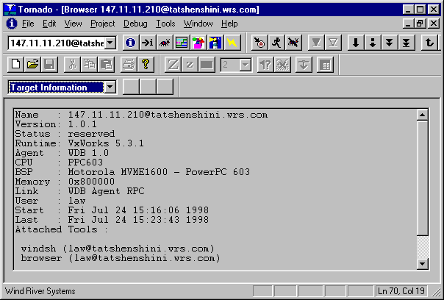
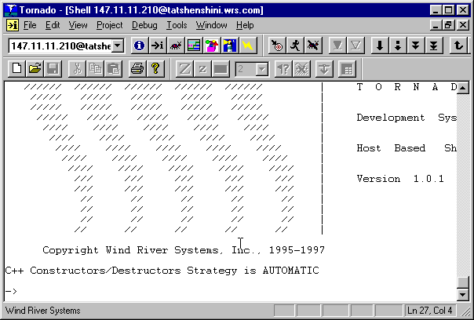
Embedded versus Desktop
Development takes place on one machine (host) and is downloaded to the embedded system (target)
JTAG
Host Computer
UART
A cross-compiler is run on the host
Target Board

Slide 6
Embedded Development
Different set of problems
Unique hardware for every design
Reliability
Real-time response requirement (sometimes)
RTOS versus OS
Code compactness
High-level languages and assembly
Notes:
Every embedded system design is unique in its function and targeted for a unique application. A design developed for one application may not work for another embedded system. Another issue is reliability. Because the system is standalone, and a combination of hardware and software, the design may have some hidden bugs that can make the system malfunction. Therefore, such a system may not be one hundred percent reliable. Depending on the application, the system may require real-time response and RTOS use, which can lead to bigger code and a larger memory requirement. Real-time systems also require assembly language programming for time-critical applications.

Slide 7
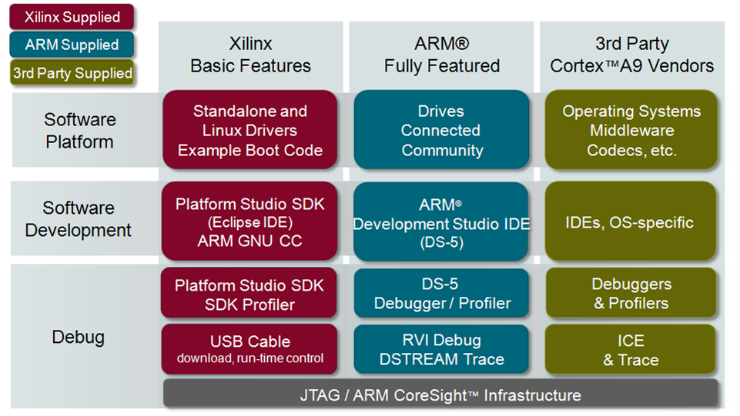
Software Development Tools

Slide 8
Outline
Introduction
SDK Development Environment
SDK Project Creation
GNU Development Tools: GCC, AS, LD, Binutils
Software Settings
Software Platform Settings
Compiler Settings
Address Management
Object File Sections
Linker Script
Summary

Slide 9
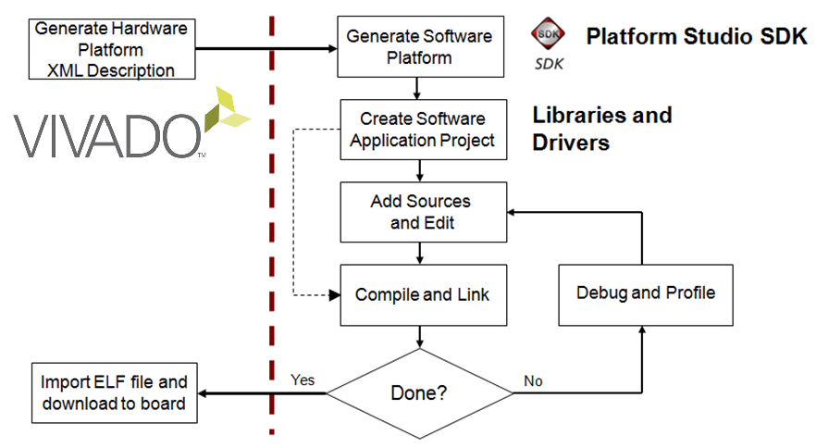
SDK Application Development Flow

Slide 10
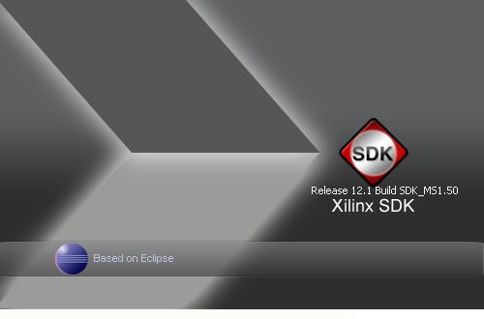
Eclipse/CDT Frameworks of SDK
Builder framework
Compiles and Links Source files
Default Build options are specified when application is created: Choice of Debug, Release, Profile configurations
User can custom build options later when developing application
Build types: Standard Make, Managed Make
Launch framework
Specifies what action needs to be taken: Run (+ Profile) application or Debug application
In SDK, this is akin to the Target Connection settings
Debug framework
Launches debugger(gdb), loads application and begins debug session
Debug views show information about state of debug session
Search framework
Helps development of application
Help System
Online help system; context-sensitive

Slide 11
Workspaces and Perspectives
Workspace
Location to store preferences & internal info about projects
Transparent to users
Source files not stored under Workspace
Views, Editors
Basic user interface element
Perspectives
Collection of functionally related views
Layout of views in a perspective can be customized according to user preference
Notes:
The SDK "Workspace" is a cumulative catalog of all application projects you create using SDK, independent of the target design. The workspace allows you to navigate between application projects to ease code reuse without having to locate the project directories in the file system. The workspace also acts as a registry to remember all your project settings. SDK creates the workspace in a predefined location when you first invoke the tool.
A perspective is a layout of views (development tools) in the Workbench window. Each type of perspective is a combination of views, menus, and toolbars that enable you to perform a particular task. For example, the C/C++ perspective has views that are organized to help you develop C/C++ programs; the Debug perspective has views that enable you to debug those programs.

Slide 12
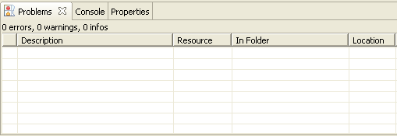
Views
Eclipse Platform views: Navigator view, Tasks view, Problems view
Debug views: Stack view, Variables view
C/C++ views: Projects view, Outline view

Slide 13
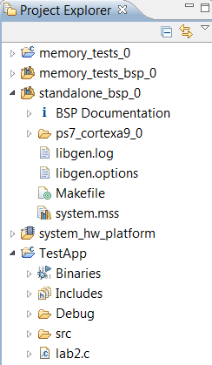
C/C++ Project View
Hierarchical list of the workspace projects in a hierarchical format
Double-click to open a file
Right-click the project to access its properties
Software Applications
Software BSP
Hardware Description
Software Applications
Notes:
There are three kinds of projects: hardware platform, software Board Support Package (BSP), and software application projects.
There must be at least one hardware platform project workspace.
There must be at least one software board support package project per hardware processor instance.
There can be many software application projects, each one being associated with a BSP project.

Slide 14
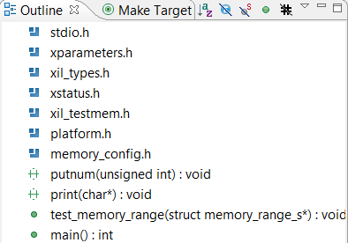
Outline View
Displays an outline of the structured file that is currently open in the editor
The contents of the outline view are editor specific
Content type is indicated by the icon
For a C source, icons represent
#define statements
Include files
Function calls
Declarations
Selecting a symbol will navigate to the same in the editor window

Slide 15
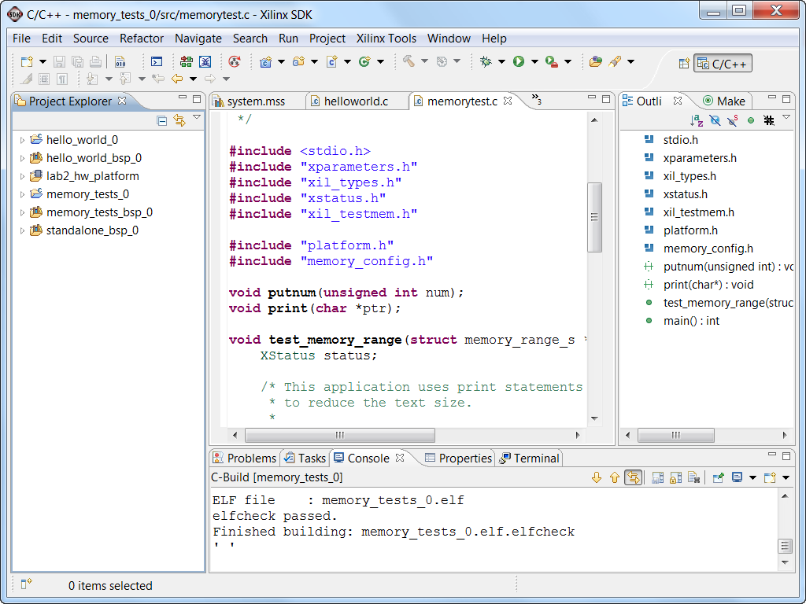
C/C++ Perspective
C/C++ project outline displays the elements of a project with file decorators (icons) for easy identification
C/C++ editor for integrated software creation
Code outline displays elements of the software file under development with file decorators (icons) for easy identification
Problems, Console, Properties view lists output information associated with the software development flow
Editor View
Project Outline
Code Outline
Console

Slide 16
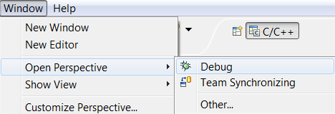
Opening Perspectives and Views
To open a Perspective, use
Window → Open Perspective
To open a view, use
Window → Show View
If the view is already present in the current perspective, the view is highlighted

Slide 17
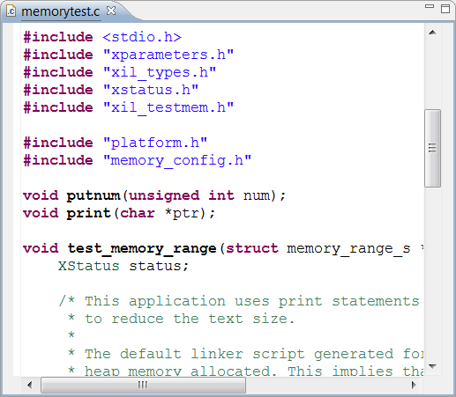
Editor
Syntax Highlighting
bracket matching
syntax coloring
content assist
refactoring
keyboard shortcuts

Slide 18
Outline
Introduction
SDK Development Environment
SDK Project Creation
GNU Development Tools: GCC, AS, LD, Binutils
Software Settings
Software Platform Settings
Compiler Settings
Address Management
Object File Sections
Linker Script
Summary

Slide 19
Launching SDK
Launch SDK
Standalone
Choose workspace, choose Hardware Platform Specification
In Vivado
File> Export
File > Launch SDK
Block Diagram needs to be Open before exporting
A Hardware Description File HDF file is first generated
A hardware platform specification project is then automatically created
The software application (and board support package) then can be created and associated with the hardware platform

Slide 20
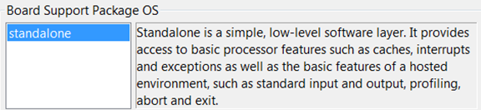
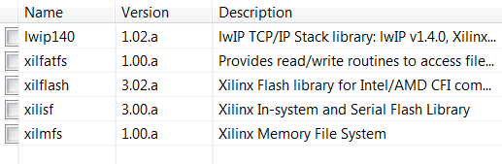

Creating a Board Support Package
The Board Support Package provides software services based on the processor and peripherals that make up the processor system
Can be automatically created when creating Application project
Can be created standalone
Must be attached to a Hardware Platform
In SDK, File > New > Xilinx Board Support Package
Select appropriate OS support
Third-party operating systems are supported with the appropriate BSP selection
Select required libraries support

Slide 21
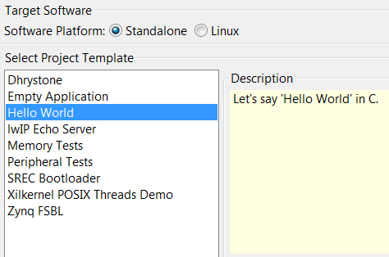
Creating a Software Application Project
SDK supports multiple software application projects
A software project is attached to a BSP project
Sample applications are provided
Great for quick test of hardware
Peripheral Tests
Starting point to base your own application on
Typically an Empty Application is opened to begin a non-standard project

Slide 22
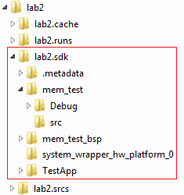
Directory Structure
SDK projects are place in the application directory that was specified when SDK was launched
Each project may have multiple directories for system files and configurations
Configurations are property tool option permutations of the software application. Each configuration has project properties set depending on needs. An ELF file is generated for each
Release configuration
Debug configuration
Profile configuration
A Debug configuration is created by default
Notes:
Configurations are used to maintain different tool options for software in different states of design, profile, debug, and release.
SDK has another selection of RUN configurations, described later.
Do not confuse the fact that the SDK tool defines configurations in two distinct tool areas.

Slide 23
Outline
Introduction
SDK Development Environment
SDK Project Creation
GNU Development Tools: GCC, AS, LD, Binutils
Software Settings
Software Platform Settings
Compiler Settings
Address Management
Object File Sections
Linker Script
Summary

Slide 24
Embedded Tool Flow (SDK)
SDK
Library Generation
Hardware
Platform Generation
Simulation
Generator
IPI
CompXLib
MSS
IP Models
HDL Models
IP Library or User Repository
SW Libraries
Library Generation
Drivers
.hdf
Platform Generation
Simulation model
Generation
.a
Libraries,
OS, MLD
HDL
System and Wrapper HDL
system.bmm
Behavioral VHD Model
Embedded Software
Development
Synthesis
Application Source .c, .h, .s
Simulation model
Generation
Compiler (GCC)
XDC
Implementation
Structural/Timing VHD Model
.o, .a
Linker Script
Linker (GCC)
system_bd.bmm
Bitstream Generation
Simulation model
Generation
ELF
Configure BRAM
system.bit
Structural/Timing VHD Model
XMD, TCF GDB
download.bit
Hardware Manager
Simulation
JTAG Cable
FPGA

Slide 25
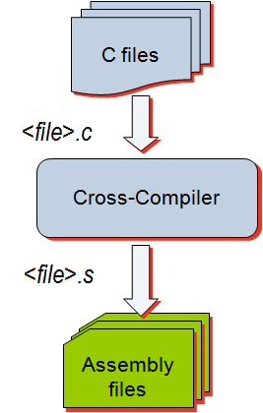
GNU Tools: GCC
GCC translates C source code into assembly language
GCC also functions as the user interface to the GNU assembler and to the GNU linker, calling the assembler and the linker with the appropriate parameters
Supported cross-compilers:
GNU GCC (arm-xilinx-eabi-gcc)
Command line only; uses the settings set through the GUI

Slide 26
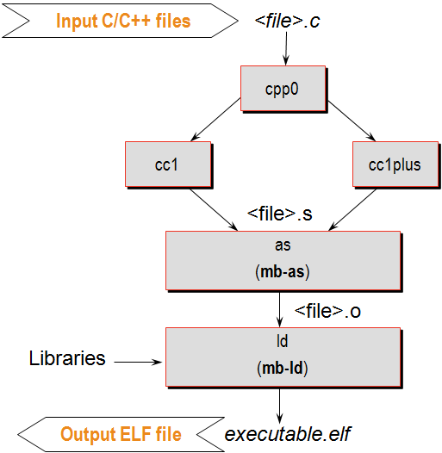
GNU Tools: GCC
Calls four different executables
Preprocessor (cpp0)
Replaces all macros with definitions defined in the source and header files
Language specific c-compiler
cc1 C-programming language
cc1plus C++ language
Assembler
arm-xilinx-eabi-as
Linker
arm-xilinx-eabi-ld
arm-xilinx-eabi-as
arm-xilinx-eabi-ld

Slide 27
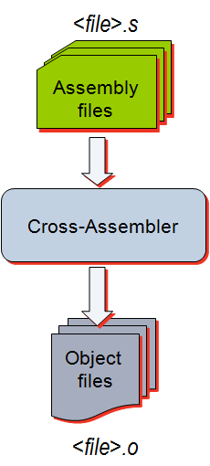
GNU Tools: AS
Input: Assembly language files
File extension: .s
Output: Object code
File extension: .o
Contains
Assembled piece of code
Constant data
External references
Debugging information
Typically, the compiler automatically calls the assembler
Use the -Wa switch if the source files are assembly only and want to use the gcc

Slide 28
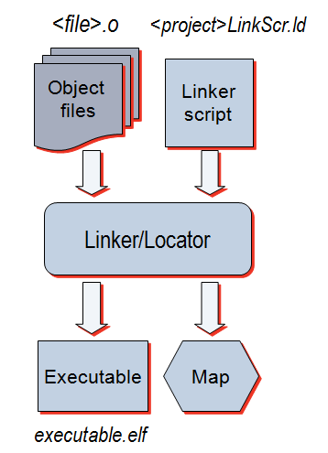
GNU Tools: LD
Linker
Inputs:
Several object files
Archived object files (library)
Linker script (mapfile)
Output:
Executable image (.ELF)
Map file

Slide 29
GNU Utilities
AR Archiver
Create, modify, and extract from libraries
Used in SDK to combine the object files of the Board Support Package (BSP) in a library
Used in SDK to extract object files from different libraries
Object Dump
Display information from object files and executables
Header information, memory map
Data
Disassemble code
Notes:
The mb-objdump (powerpc-eabi-objdump) utility lets you see the contents of an object (.o) or executable (.out) file.
To see your symbol table, the size of your file, and the names or sizes of the sections in the file, run:
mb-objdump -x a.out
To see a listing of the (assembly) code in your object or executable file, run:
mb-objdump -d a.out
To get a list of other options, run:
mb-objdump --help

Slide 30
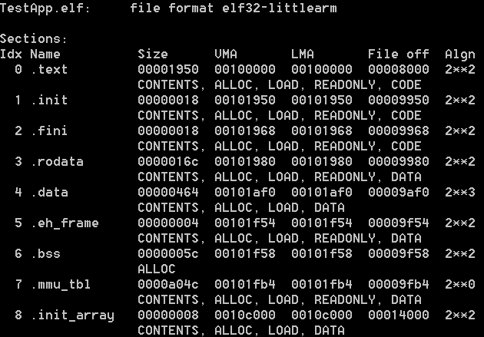
Object Dump Display summary information from the section headers
arm-xilinx-eabi-objdump –h executable.elf
Section
Name
Byte alignment
Virtual Memory Address
Loadable Memory Address
Section Size
Offset from the beginning of the section header table

Slide 31
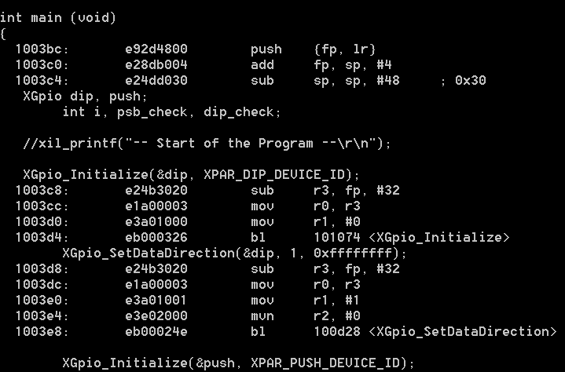
Object Dump Dumping the source and assembly code
arm-xilinx-eabi-objdump –S executable.elf
Memory location
C code instruction
Assembly instruction
Machine Language Instruction

Slide 32
Outline
Introduction
SDK Development Environment
SDK Project Creation
GNU Development Tools: GCC, AS, LD, Binutils
Software Settings
Software Platform Settings
Compiler Settings
Address Management
Object File Sections
Linker Script
Summary

Slide 33
Minimal Required Services
C language standard services
C language construct services
stdin and stdout
Math library
malloc
Processor support requires these services
Interrupt
Cache
Language environment support

Slide 34
Operating Systems
Operating systems are a collection of software routines that comprise a unified and standard set of system services
The Standalone option is used when no operating system is desired
Provides a minimal amount of processor and library services as previously illustrated
Can be considered a minimal, non-standard operating system
Installed as a software platform
Variety of third-party operating systems are available
Linux – many flavors
RTOS – real-time operating system; also has many flavors; Free RTOS (an option for the Cortex™-A9 processor)
XilKernel – provided by Xilinx; small and simple; only for MicroBlaze
Operating systems are installed and become part of the Board Support Package (BSP)

Slide 35
What an Operating System Provides?
Operating system services
GUI support
TCP/IP services**
Task management
Resource management**
Familiar programming services and tasks
Easy connection to already written applications
Ability to reload and change applications
Full file system services**
** Also available as additions to the Standalone BSP

Slide 36
Do I Need an Operating System?
The Standalone BSP includes the previously discussed items
Design considerations for systems using the Standalone BSP
All services needed are included in the BSP
The application is static—it never changes
The application fits in block RAM (MicroBlaze™ processor), OCM RAM (Zynq™ AP SoC), or DDR memory
The application is single-task based
Interrupts may or may not be used

Slide 37
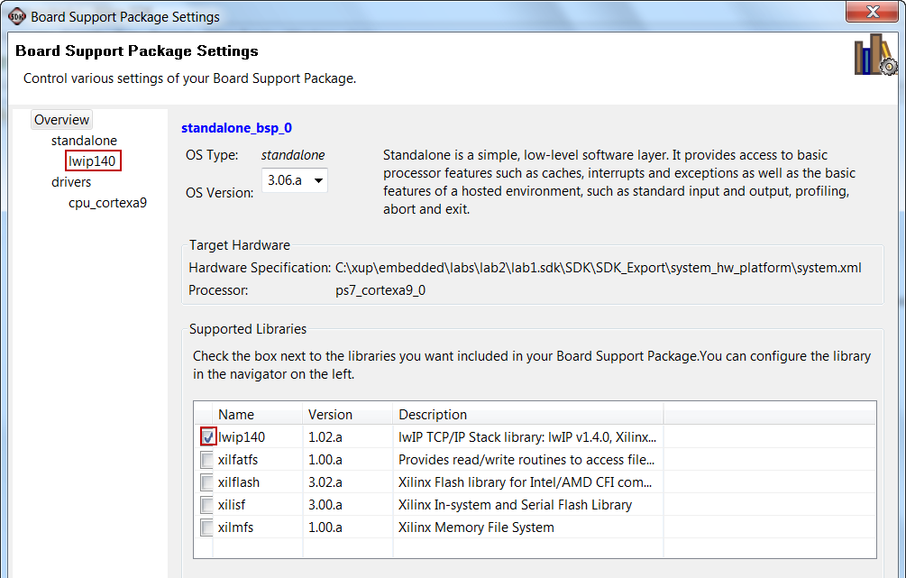
Accessing Software Platform Properties
Select the created board support package in the Project Explorer view
Xilinx Tools > Board Support Package Settings
Sets all of the software BSP related options in the design
Has multiple forms selection
Overview
Standalone
Drivers
CPU
As individual Standalone services are selected a configurable menu selection item will appear
Notes:
Open the Software Platform Settings dialog box by selecting Tools → Software Platform Settings. This dialog box has multiple forms and is used to set all the software platform-related options in the design.
Overview:
This form allows you to select the OS version and services.
You can also select available libraries support in this form. Depending on the library that you select in this form, a configuration panel menu selection will appear under the Standalone menu.
Standalone:
This form shows a list of all configurable devices (stdin/stdout). You can also select if you want to perform profiling and a timer to be used in profiling. If any library support is selected in the Overview form, and menu of the service’s configurable parameters will be presented under the Standalone menu.
Drivers:
This form allows you to specify values for the parameters associated with the peripheral drivers in the design.
CPU:
Tool chain options and their settings.

Slide 38
Embedded Tool Flow (SDK)
Library Generation
Hardware
Platform Generation
Simulation
Generator
IPI
CompXLib
MSS
IP Models
HDL Models
IP Library or User Repository
SW Libraries
Library Generation
Drivers
.hdf
Platform Generation
Simulation model
Generation
.a
Libraries,
OS, MLD
HDL
System and Wrapper HDL
system.bmm
Behavioral VHD Model
Embedded Software
Development
Synthesis
Application Source .c, .h, .s
Simulation model
Generation
Compiler (GCC)
XDC
Implementation
Structural/Timing VHD Model
.o, .a
Linker Script
Linker (GCC)
system_bd.bmm
Bitstream Generation
Simulation model
Generation
ELF
Configure BRAM
system.bit
Structural/Timing VHD Model
XMD, TCF GDB
download.bit
Hardware Manager
Simulation
JTAG Cable
FPGA

Slide 39
Library Generation Flow (in SDK)
Library Generator
Input files → MSS
Output files → libc.a, libXil.a, libm.a
LibGen is generally the first tool run to configure libraries and device drivers
The MSS file defines the drivers associated with peripherals, standard input/output devices, and other related software features
LibGen configures libraries and drivers with this information and produces an archive of object files:
libc.a - Standard C library
libXil.a - Xilinx library
libm.a - Math functions library
Notes:
Software Files
MSS
An MSS file is supplied by the user as an input to the Library Generator (LibGen). The MSS file contains directives for customizing operating systems, libraries, and drivers
Linker script
The linker script describes the mapping among all the sections in all the input object files and the output executable file. This file is used by the GNU linker
Base System Builder will create a linker script for you
If your address map specifies that the LMB, OPB, and external memory occupy contiguous areas of memory, you can use the BSB-created linker script to generate your executable
C/C++ source files
Source code and header files written by the user

Slide 40
Outline
Introduction
SDK Development Environment
SDK Project Creation
GNU Development Tools: GCC, AS, LD, Binutils
Software Settings
Software Platform Settings
Compiler Settings
Address Management
Object File Sections
Linker Script
Summary

Slide 41
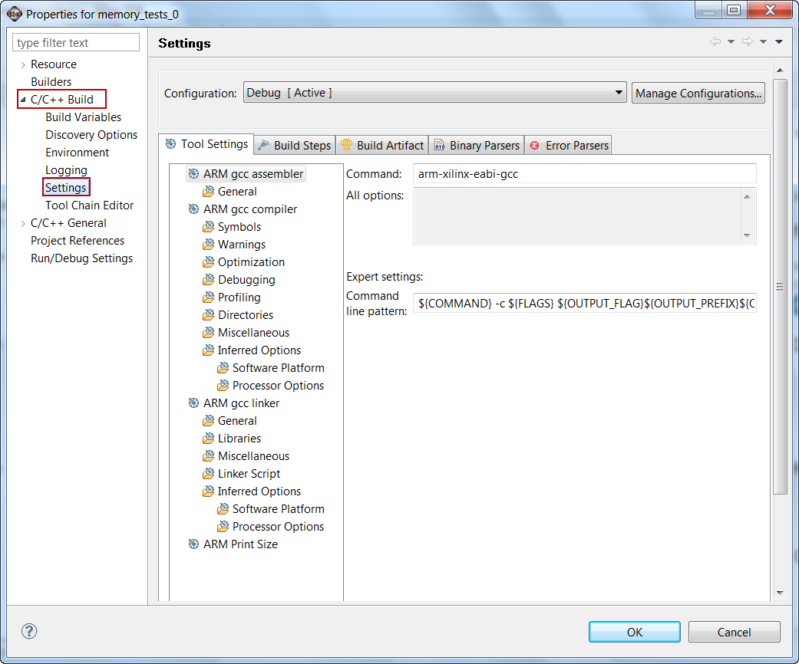
C/C++ Build Settings
Right-click the top level of an application project and select C/C++ Build Settings
Most-accessed properties are in the C/C++ Build panel Settings tab
Each configuration has its own properties
Set options for this configuration
Tool settings for assembler, compiler, and linker

Slide 42
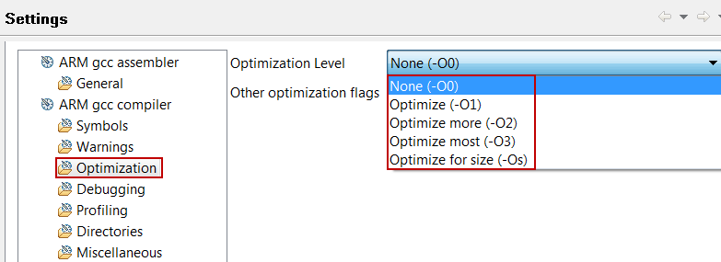
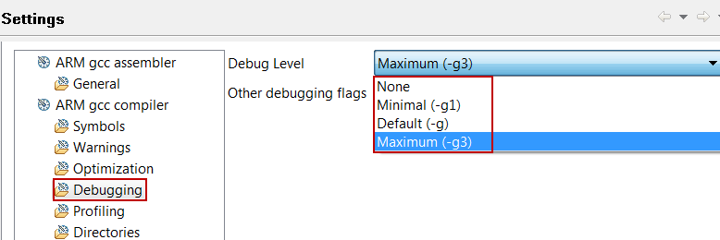
Debug/Optimization Properties
Compiler optimization level
None
Low
Medium
High
Size Optimized
Enable debug symbols in executable
Necessary for debugging
Set optimization level to none if possible

Slide 43
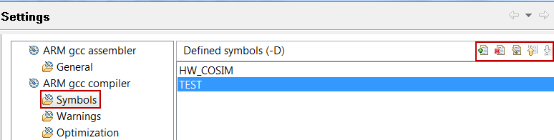
Miscellaneous Compiler Properties
Define symbols for conditional compiling
Add
Delete
Edit
References C source #ifdef symbol conditional statements #endif
Passed to compiler as –D option
Other compiler options are available
Add, Delete, Edit Icons

Slide 44
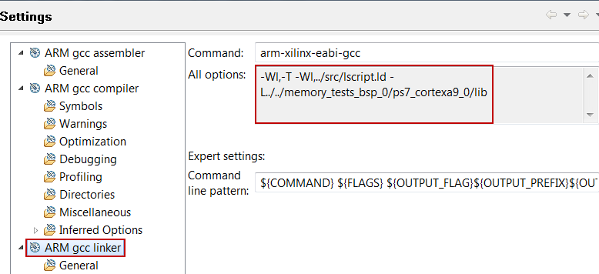
Linker Properties
The Root panel displays properties for the selected configuration
Shown are the linker options for the Debug configuration
Default settings are fine for simple applications
Notes:
The Linker Properties view allows you to set location of additional libraries (seldom used featrue. A typical example would be using the TCP/IP stack service contained in the Lwip library, an optional part of the Standalone BSP. The library requires the (-l) flag to be set to -llwip4.
The Miscellaneous tab allows other linker options to be set. Normally this is left blank. A possible use is to view the map cross-reference file that is not automatically generated by the linker. Use the following linker option to generate it: -Wl,-Map,outputfile.txt (no spaces).

Slide 45
Outline
Introduction
SDK Development Environment
SDK Project Creation
GNU Development Tools: GCC, AS, LD, Binutils
Software Settings
Software Platform Settings
Compiler Settings
Address Management
Object File Sections
Linker Script
Summary

Slide 46
Address Management
Embedded processor design requires you to manage the following:
Address map for the peripherals
Location of the application code in the memory space
Block RAM
External memory (Flash, DDR3, SRAM)
Memory requirements for your programs are based on the following:
The amount of memory required for storing the instructions
The amount of memory required for storing the data associated with the program

Slide 47
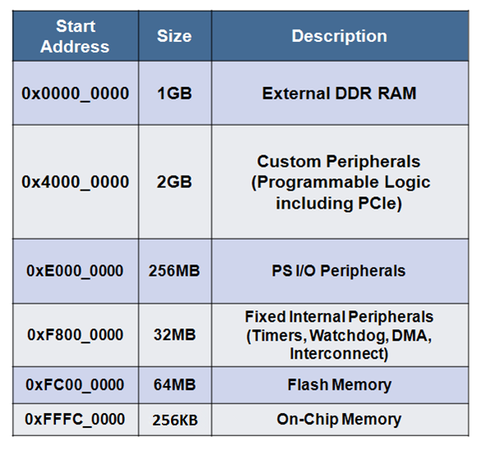
Standard ARM Programming Model
Processing system and programmable logic look the same
AMBA® and AXI interfaces
Memory-mapped I/O
Register access
Consistency for PS and PL = ease of use
Memory map usage: total of 4 GB
1 GB: DDR RAM
2 GB: dedicated to PL peripherals
1 GB: PS peripherals, OCM, external flash

Slide 48
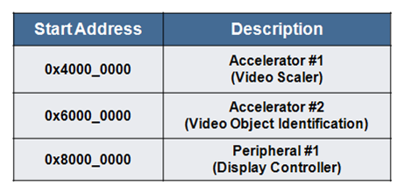
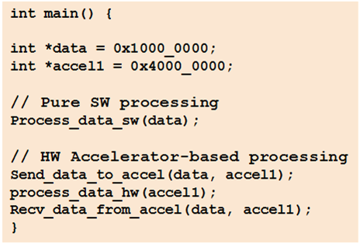
Programmer’s View of Programmable Logic
Programmable logic (PL) memory map
2 GB total space
1 GB for each AXI master: GP0, and GP1
Accessible from any processing system (PS) master
Either Cortex-A9 CPU
PS DMA engine
PS peripheral DMA engine
Ethernet
USB
SD/SDIO
Custom Peripheral Code Snippet

Slide 49
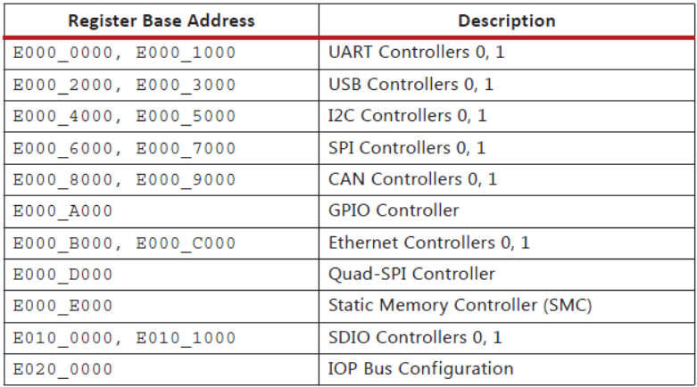
Address Map: I/O Peripherals (Zynq AP SoC)

Slide 50
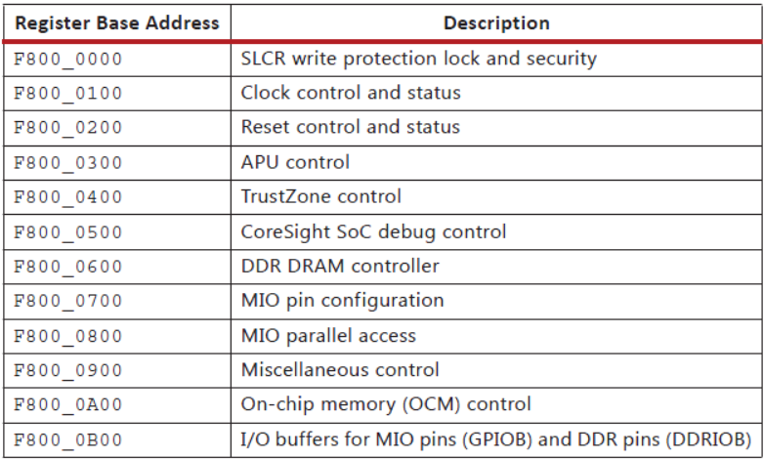
Address Map: SLCR Registers (Zynq AP SoC)

Slide 51
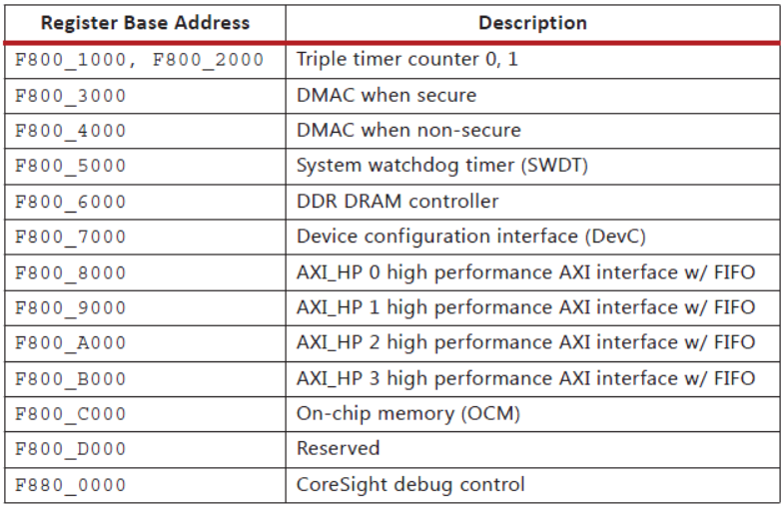
Address Map: PS Registers (Zynq AP SoC)

Slide 52
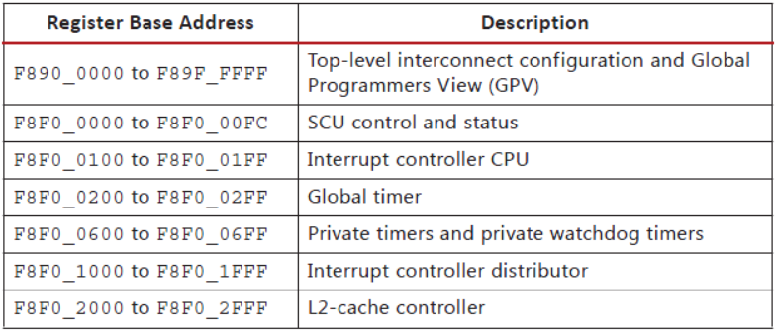
Address Map: CPU Private Bus Registers

Slide 53
Outline
Introduction
SDK Development Environment
SDK Project Creation
GNU Development Tools: GCC, AS, LD, Binutils
Software Settings
Software Platform Settings
Compiler Settings
Address Management
Object File Sections
Linker Script
Summary

Slide 54
Object File Sections
What is an object file?
An object file is an assembled piece of code
Machine language: li r31,0 = 0x3BE0 0000
Constant data
There may be references to external objects that are defined elsewhere
This file may contain debugging information

Slide 55
Object File Sections Sectional layout of an object or an executable file
.text
.rodata
.sdata2
.sbss2
.data
.sdata
.sbss
.bss
Text section
Read-only data section
Small read-only data section (less than eight bytes)
Small read-only uninitialized data section
Read-write data section
Small read-write data section
Small uninitialized data section
Uninitialized data section
Notes:
The .text section contains executable code. This section has the x (executable), r (read-only) and i (initialized) flags.
The .rodata section contains read-only data of a size more than 8 bytes (default). The size of the data put into this section can be changed with an mb-gcc -G option. All data in this section is accessed using absolute addresses.
The .sdata2 section contains small read-only data (size less than 8 bytes). The size of the data going into this section can be changed with an mb-gcc -G option. All data in this section is accessed with reference to the read-only small data anchor. This ensures that all data in the .sdata2 section can be accessed using a single instruction (a preceding imm instruction will never be necessary). This section has the r (read-only) and the i (initialized) flags.
This .sbss2 section contains small, read-only un-initialized data of a size less than 8 bytes. You can change the size of the data going into this section with the -G option. This section has the r(read) flag and can be mapped to ROM.
The .data section contains read-write data of a size more than 8 bytes (default). The size of the data going into this section can be changed with an mb-gcc -G option. All data in this section is accessed using absolute addresses. This section has the w (read-write) and the i (initialized) flags.
The .sdata section contains small read-write data of a size less than 8 bytes (default). The size of the data going into this section can be changed with an mb-gcc -G option. All data in this section is accessed with reference to the read-write small data anchor. This ensures that all data in the .sdata section uses a single instruction (a preceding imm instruction will never be necessary). This section has the w (read-write) and the i (initialized) flags.
The .sbss section contains small uninitialized data of a size less than 8 bytes (default). The size of the data going into this section can be changed with an mb-gcc -G option. This section has the w (read-write) flag.
The .bss section contains uninitialized data of a size more than 8 bytes (default). The size of the data going into this section can be changed with an mb-gcc -G option. All data in this section is accessed using absolute addresses. The stack and the heap are also allocated to this section. This section has the w (read-write) flag.

Slide 56
Sections Example
int ram_data[10] = {0,1,2,3,4,5,6,7,8,9}; /* DATA */
const int rom_data[10] = {9,8,7,6,5,4,3,2,1}; /* RODATA */
int I; /* BSS */
main(){
...
I = I + 10; /* TEXT */
...
}

Slide 57
Object File Sections Reserved sections that you typically would not modify
.init
.fini
.ctors
.dtors
.got
.got2
.eh_frame
Language initialization code
Language cleanup code
List of functions to be invoked at program startup
List of functions to be invoked at program end
Pointers to program data
Pointers to program data
Frame unwind information for exception handling
Notes:
The .init section contains language initialization code. This section has the same flags as .text. This must be mapped to initialized ROM.
The .fini section contains language cleanup code. This section has the same flags as .text. This must be mapped to initialized ROM.
The .ctors section contains a list of functions that must be invoked at program startup. This section contains the same flags as .data and must be mapped to initialized RAM.
The .dtors section contains a list of functions that must be invoked at program end. This section contains the same flags as .data and must be mapped to initialized RAM.
The .got2/.got sections contain pointers to program data. This section contains the same flags as .data and must be mapped to initialized RAM.
The .eh_frame section contains frame unwind information for exception handling. This section contains the same flags as .rodata and can be mapped to initialized ROM

Slide 58
Outline
Introduction
SDK Development Environment
SDK Project Creation
GNU Development Tools: GCC, AS, LD, Binutils
Software Settings
Software Platform Settings
Compiler Settings
Address Management
Object File Sections
Linker Script
Summary

Slide 59
Linker Script
Linker script controls the linking process
Map the code and data to a specified memory space
Set the entry point to the executable
Reserve space for the stack
Required if the design contains a discontinuous memory space

Slide 60
Linker and Locator Flows
foo1.o
Executable Image
Merged Output Sections
0xFFFF
.text1
Code
.data1
0xF000
.text
Locate
.bss1
0xEFFF
Link
.data
uninitialized data
0xEF00
foo2.o
0xEEFF
.bss
Unused
.text2
0x2000
.data2
0x1FFF
Initialized data
.bss2
0x0000

Slide 61
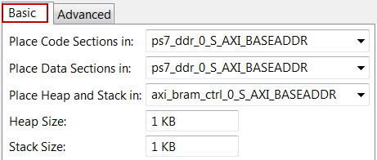
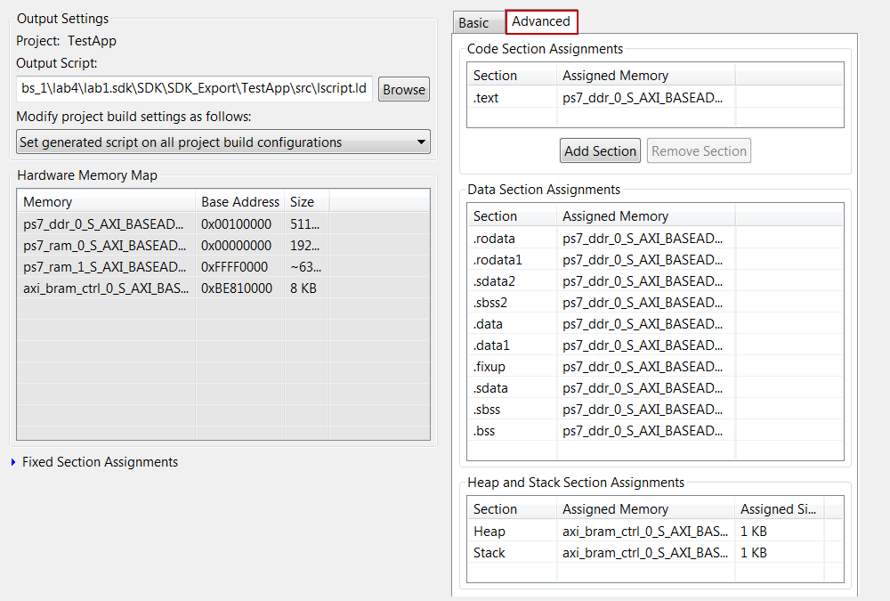
Linker Script Generator GUI
Table-based GUI allows you to define the memory space for code and data sections
Launch from Xilinx Tools > Generate Linker Script, or from the C/C++ perspective, right-click on <project> > Generate Linker Script
The tool will create a new linker script (the old script is backed up)

Slide 62
Outline
Introduction
SDK Development Environment
SDK Project Creation
GNU Development Tools: GCC, AS, LD, Binutils
Software Settings
Software Platform Settings
Compiler Settings
Address Management
Object File Sections
Linker Script
Summary

Slide 63
Summary
Software development for an embedded system in FPGA imposes unique challenges due to unique hardware platform
SDK provides many rich perspectives which enable ease of accessing information through related views
GNU tools are used for compiling C/C++ source files, linking, creating executable output, and debugging
Software platform settings allow inclusion of software library support
Compiler settings provide switches including compiling, linking, debugging, and profiling

Slide 64
Summary
Embedded processor design requires you to manage
Peripheral address space
Memory address space to store data and instructions
Internal block memory
External memory
Linker script is required when the software segments do not reside in a contiguous memory space

